Slide 1
Jakirul Islam ID. 193002101 Department of CSE
Presentation on Set

Slide 2
SET
A set is an unordered collection of different elements.
Some Example of Sets:
A set of all positive integers
A set of all the planets in the solar system.

Slide 3
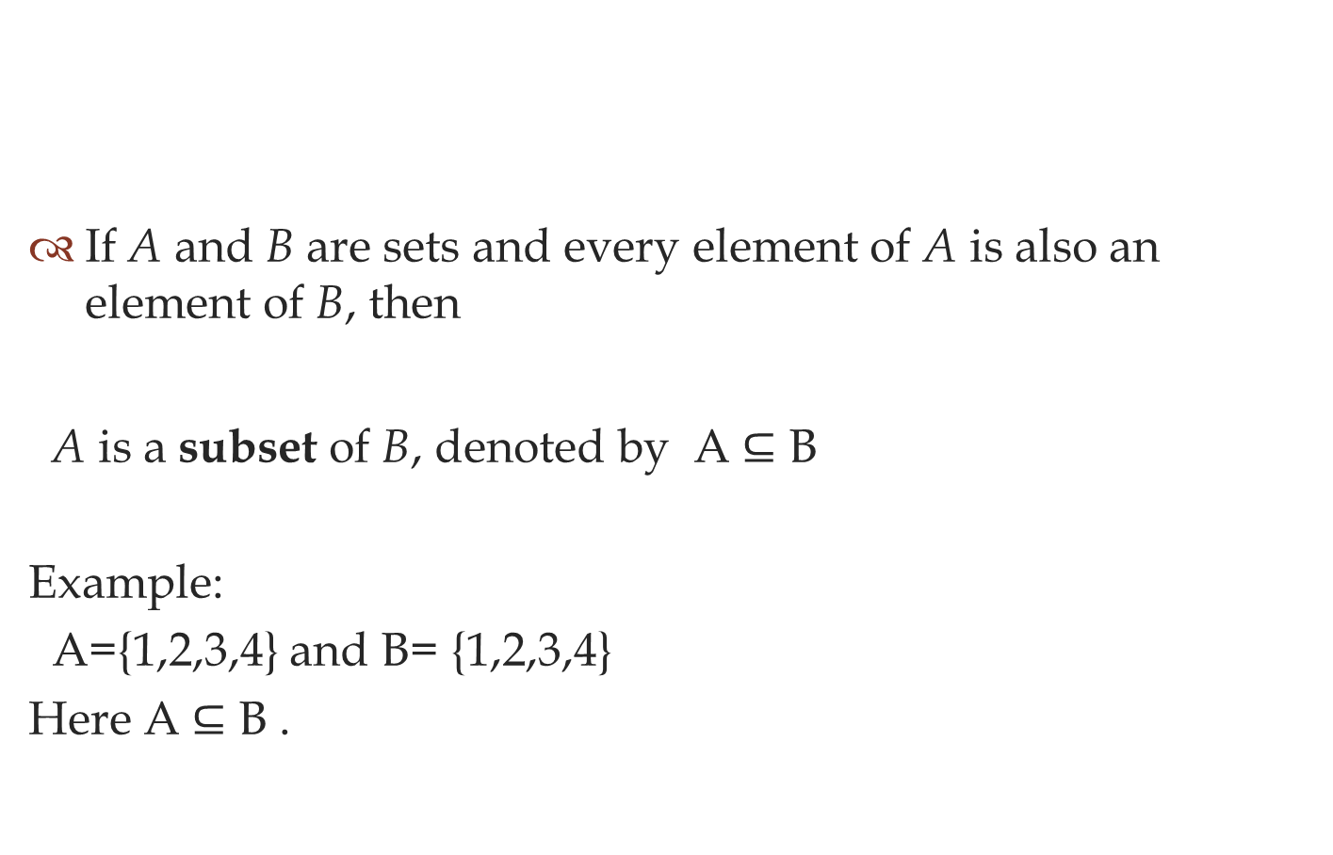
SUBSET
If A and B are sets and every element of A is also an element of B, then
A is a subset of B, denoted by A ⊆ B
Example:
A={1,2,3,4} and B= {1,2,3,4}
Here A ⊆ B .

Slide 4
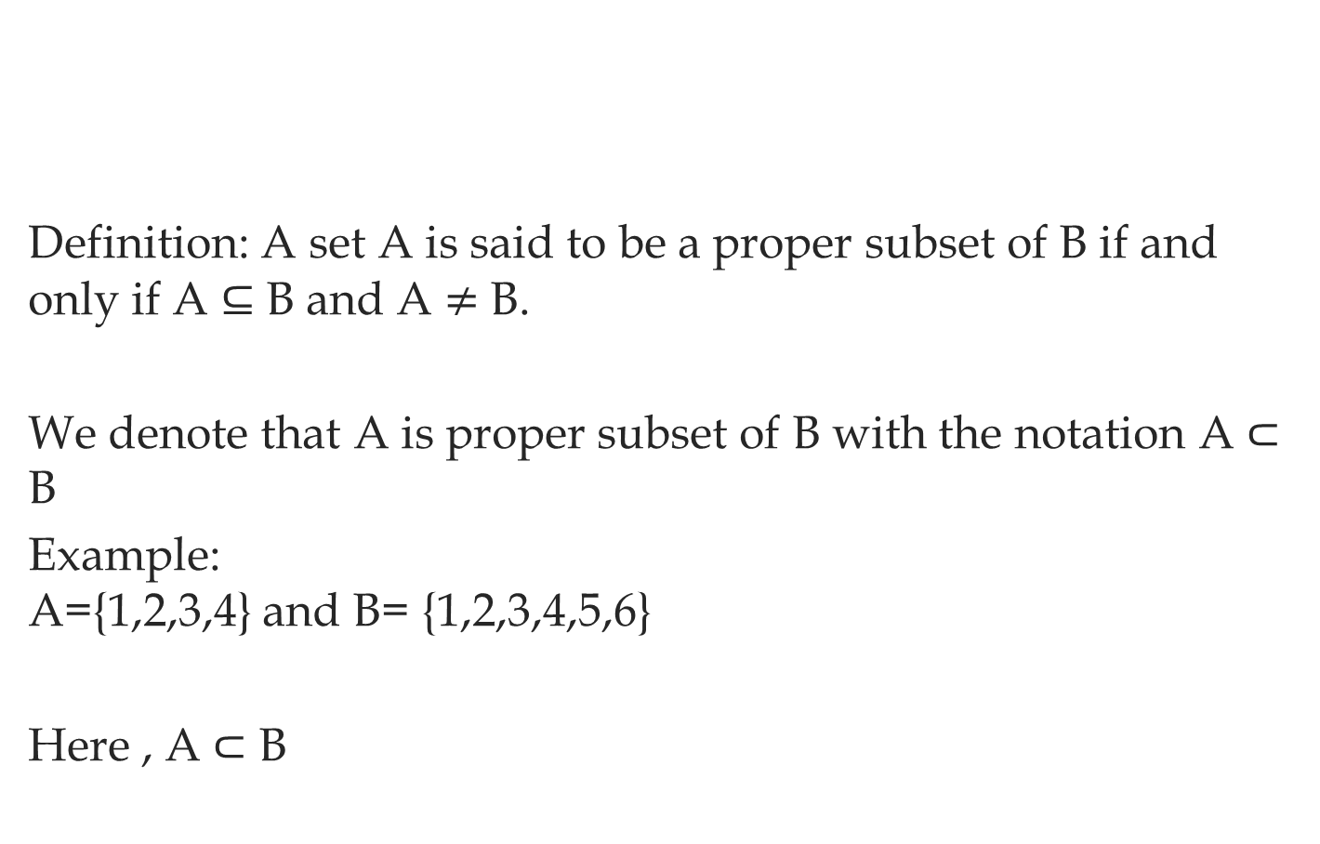
Proper Subset
Definition: A set A is said to be a proper subset of B if and only if A ⊆ B and A $≠$ B.
We denote that A is proper subset of B with the notation A ⊂ B
Example: A={1,2,3,4} and B= {1,2,3,4,5,6}
Here , A ⊂ B

Slide 5
Cardinality
The cardinality of a set is a measure of the "number of elements of the set".
for example:
the set A={2,4,6}
contains 3 elements,
and therefore A has a cardinality of 3.

Slide 6
Thank you

